Slide 1

Database Systems: Design, Implementation, and Management Ninth Edition
Chapter 10
Transaction Management
and Concurrency Control

Slide 2
Objectives
In this chapter, you will learn:
About database transactions and their properties
What concurrency control is and what role it plays in maintaining the database’s integrity
What locking methods are and how they work
Database Systems, 9th Edition
‹#›

Slide 3
Objectives (cont’d.)
How stamping methods are used for concurrency control
How optimistic methods are used for concurrency control
How database recovery management is used to maintain database integrity
Database Systems, 9th Edition
‹#›

Slide 4
What Is a Transaction?
Logical unit of work that must be either entirely completed or aborted
Successful transaction changes database from one consistent state to another
One in which all data integrity constraints are satisfied
Most real-world database transactions are formed by two or more database requests
Equivalent of a single SQL statement in an application program or transaction
Database Systems, 9th Edition
‹#›

Slide 5
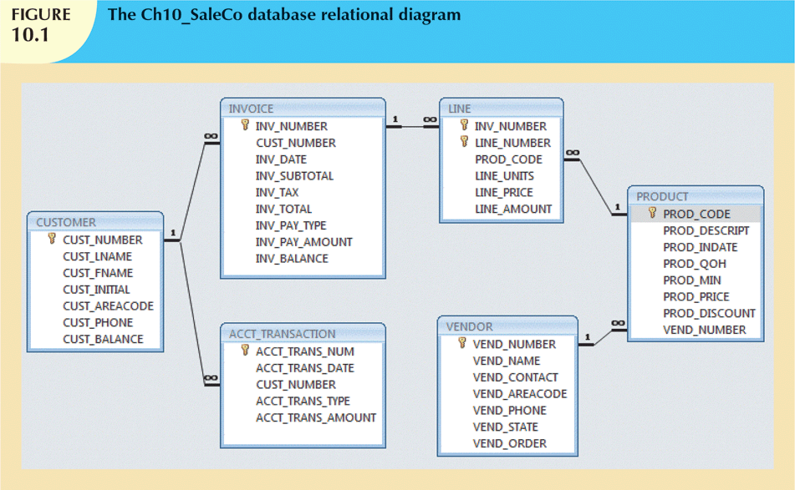
Database Systems, 9th Edition
‹#›

Slide 6
Evaluating Transaction Results
Not all transactions update database
SQL code represents a transaction because database was accessed
Improper or incomplete transactions can have devastating effect on database integrity
Some DBMSs provide means by which user can define enforceable constraints
Other integrity rules are enforced automatically by the DBMS
Database Systems, 9th Edition
‹#›

Slide 7
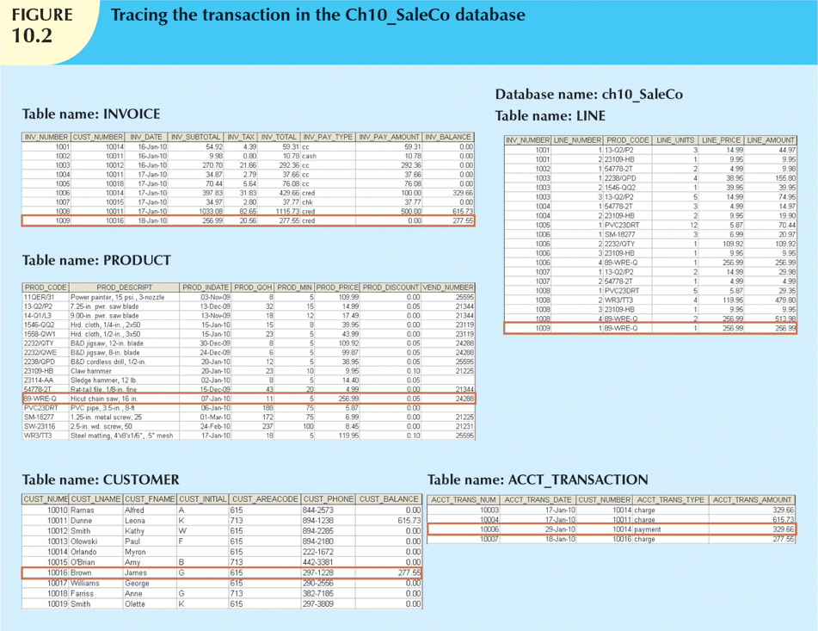
Figure 9.2
Database Systems, 9th Edition
‹#›

Slide 8
Transaction Properties
Atomicity
All operations of a transaction must be completed
Consistency
Permanence of database’s consistent state
Isolation
Data used during transaction cannot be used by second transaction until the first is completed
ACID
Database Systems, 9th Edition
‹#›

Slide 9
Transaction Properties (cont’d.)
Durability
Once transactions are committed, they cannot be undone
Serializability
Concurrent execution of several transactions yields consistent results
Multiuser databases are subject to multiple concurrent transactions
Database Systems, 9th Edition
‹#›

Slide 10
Transaction Management with SQL
ANSI has defined standards that govern SQL database transactions
Transaction support is provided by two SQL statements: COMMIT and ROLLBACK
Transaction sequence must continue until:
COMMIT statement is reached
ROLLBACK statement is reached
End of program is reached
Program is abnormally terminated
Database Systems, 9th Edition
‹#›

Slide 11
The Transaction Log
Transaction log stores:
A record for the beginning of transaction
For each transaction component:
Type of operation being performed (update, delete, insert)
Names of objects affected by transaction
“Before” and “after” values for updated fields
Pointers to previous and next transaction log entries for the same transaction
Ending (COMMIT) of the transaction
Database Systems, 9th Edition
‹#›

Slide 12
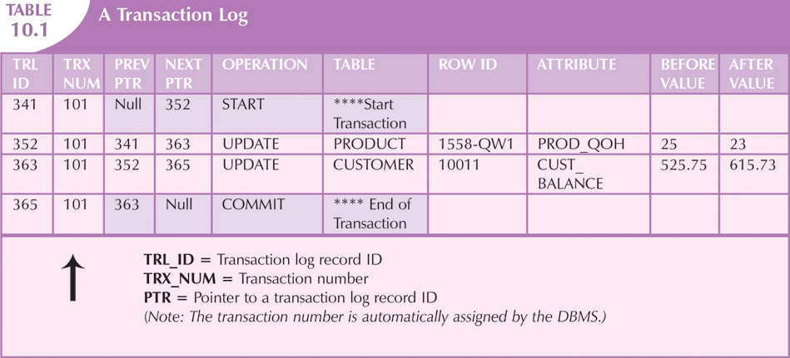
Database Systems, 9th Edition
‹#›

Slide 13
Concurrency Control
Coordination of simultaneous transaction execution in a multiprocessing database
Objective is to ensure serializability of transactions in a multiuser environment
Three main problems:
Lost updates
Uncommitted data
Inconsistent retrievals
Database Systems, 9th Edition
‹#›

Slide 14
Lost Updates
Lost update problem:
Two concurrent transactions update same data element
One of the updates is lost
Overwritten by the other transaction
Database Systems, 9th Edition
‹#›

Slide 15

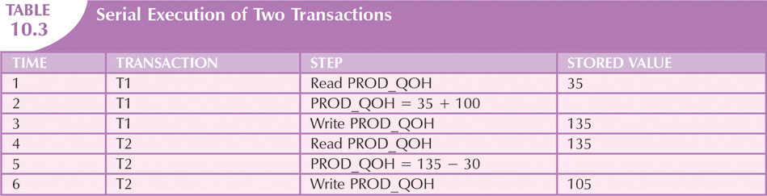
Database Systems, 9th Edition
‹#›

Slide 16
Uncommitted Data
Uncommitted data phenomenon:
Two transactions are executed concurrently
First transaction rolled back after second already accessed uncommitted data
Database Systems, 9th Edition
‹#›

Slide 17
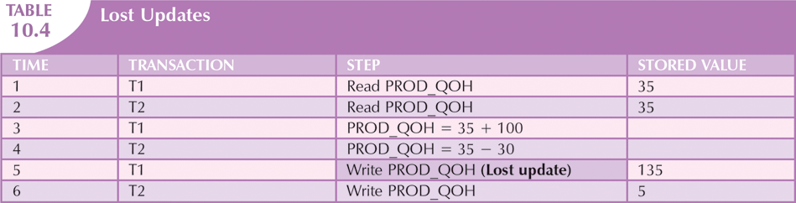

Database Systems, 9th Edition
‹#›

Slide 18
Inconsistent Retrievals
Inconsistent retrievals:
First transaction accesses data
Second transaction alters the data
First transaction accesses the data again
Transaction might read some data before they are changed and other data after changed
Yields inconsistent results
Database Systems, 9th Edition
‹#›

Slide 19
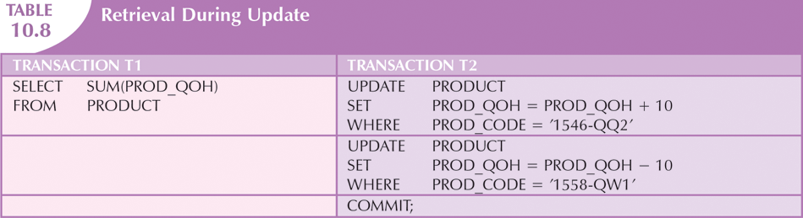
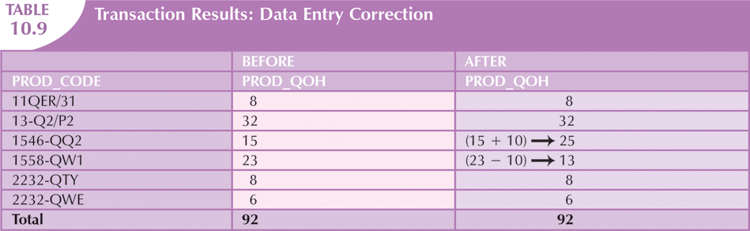
Database Systems, 9th Edition
‹#›

Slide 20
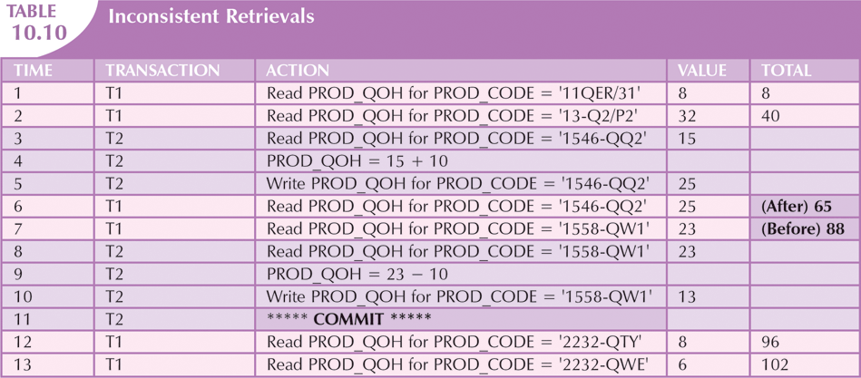
Database Systems, 9th Edition
‹#›

Slide 21
The Scheduler
Special DBMS program
Purpose is to establish order of operations within which concurrent transactions are executed
Interleaves execution of database operations:
Ensures serializability
Ensures isolation
Serializable schedule
Interleaved execution of transactions yields same results as serial execution
Database Systems, 9th Edition
‹#›

Slide 22
Concurrency Control with Locking Methods
Lock
Guarantees exclusive use of a data item to a current transaction
Required to prevent another transaction from reading inconsistent data
Lock manager
Responsible for assigning and policing the locks used by transactions
Database Systems, 9th Edition
‹#›

Slide 23
Lock Granularity
Indicates level of lock use
Locking can take place at following levels:
Database
Table
Page
Row
Field (attribute)
Database Systems, 9th Edition
‹#›

Slide 24
Lock Granularity (cont’d.)
Database-level lock
Entire database is locked
Table-level lock
Entire table is locked
Page-level lock
Entire diskpage is locked
Database Systems, 9th Edition
‹#›

Slide 25
Lock Granularity (cont’d.)
Row-level lock
Allows concurrent transactions to access different rows of same table
Even if rows are located on same page
Field-level lock
Allows concurrent transactions to access same row
Requires use of different fields (attributes) within the row
Database Systems, 9th Edition
‹#›

Slide 26
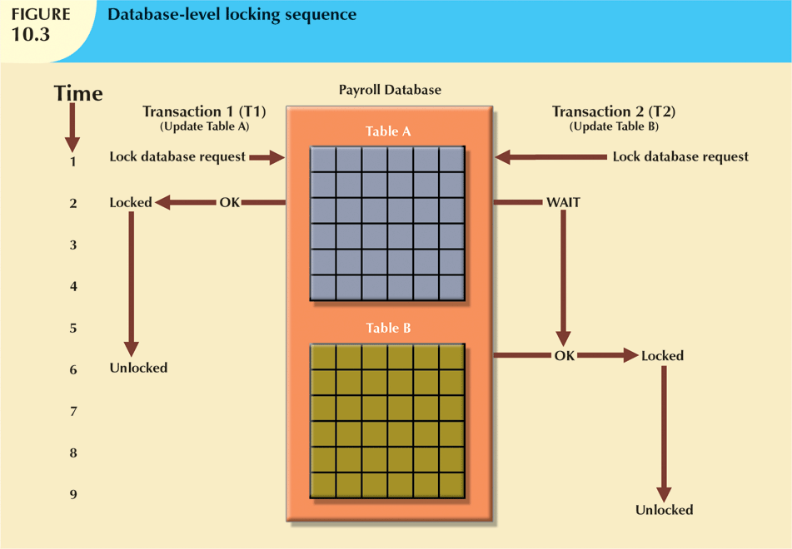
Database Systems, 9th Edition
‹#›

Slide 27
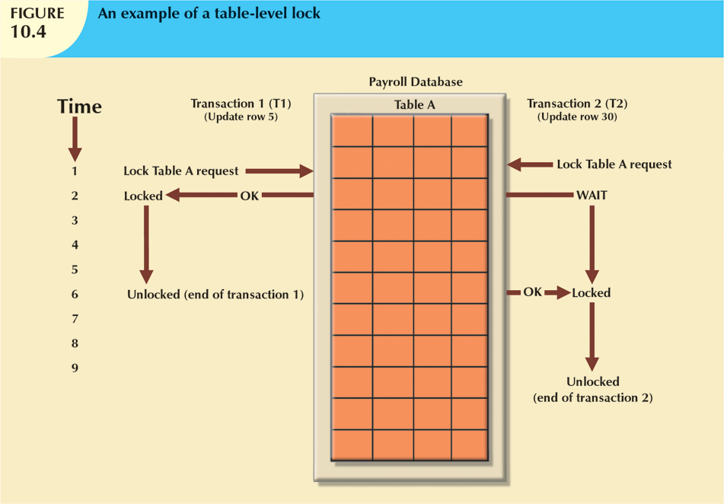
Database Systems, 9th Edition
‹#›

Slide 28
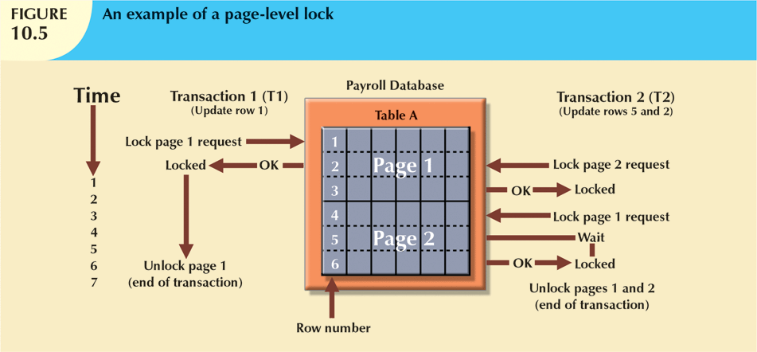
Database Systems, 9th Edition
‹#›

Slide 29
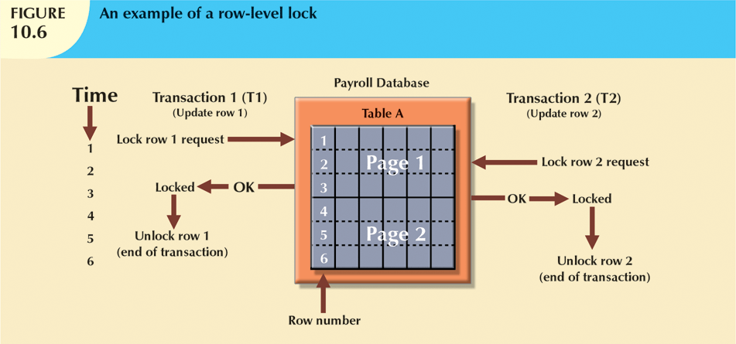
Database Systems, 9th Edition
‹#›

Slide 30
Lock Types
Binary lock
Two states: locked (1) or unlocked (0)
Exclusive lock
Access is specifically reserved for transaction that locked object
Must be used when potential for conflict exists
Shared lock
Concurrent transactions are granted read access on basis of a common lock
Database Systems, 9th Edition
‹#›

Slide 31
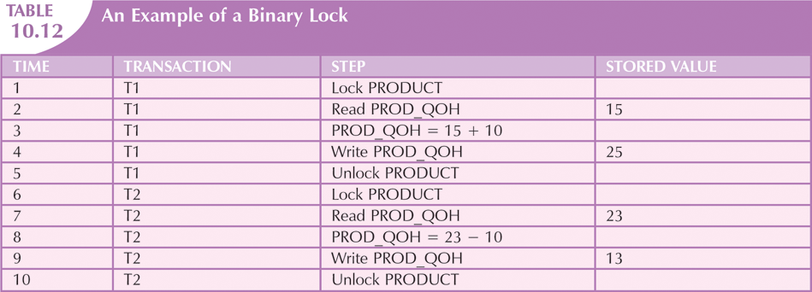
Database Systems, 9th Edition
‹#›

Slide 32
Two-Phase Locking to Ensure Serializability
Defines how transactions acquire and relinquish locks
Guarantees serializability, but does not prevent deadlocks
Growing phase
Transaction acquires all required locks without unlocking any data
Shrinking phase
Transaction releases all locks and cannot obtain any new lock
Database Systems, 9th Edition
‹#›

Slide 33
Two-Phase Locking to Ensure Serializability (cont’d.)
Governed by the following rules:
Two transactions cannot have conflicting locks
No unlock operation can precede a lock operation in the same transaction
No data are affected until all locks are obtained
Database Systems, 9th Edition
‹#›

Slide 34
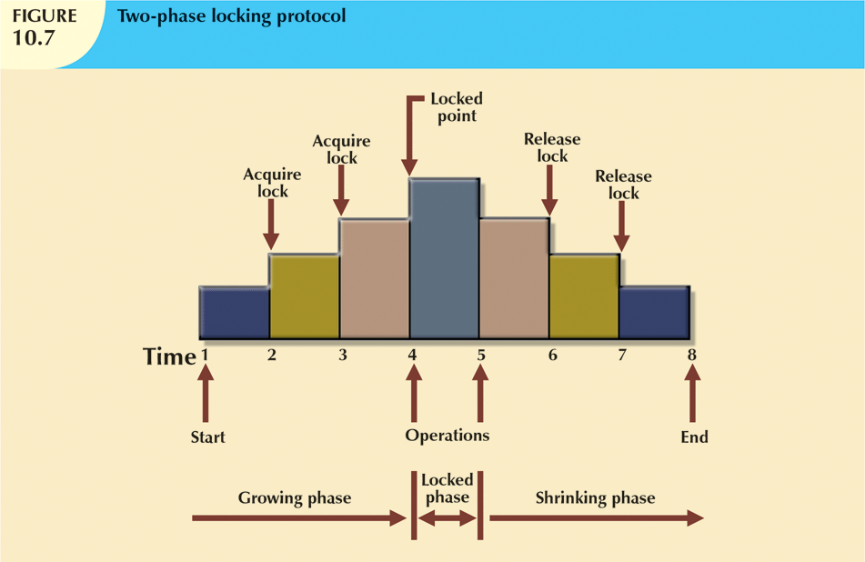
Database Systems, 9th Edition
‹#›

Slide 35
Deadlocks
Condition that occurs when two transactions wait for each other to unlock data
Possible only if one of the transactions wants to obtain an exclusive lock on a data item
No deadlock condition can exist among shared locks
Database Systems, 9th Edition
‹#›

Slide 36
Deadlocks (cont’d.)
Three techniques to control deadlock:
Prevention
A transaction requesting a new lock is aborted when there is the possibility that a deadlock can occur. If the transaction is aborted, all changes made by this transaction are rolled back and all locks obtained by the transaction are released. The transaction is then rescheduled for execution. Deadlock prevention works because it avoids the conditions that lead to deadlocking.
Detection
Avoidance
The transaction must obtain all of the locks it needs before it can be executed. This technique avoids the rolling back of conflicting transactions by requiring that locks be obtained in succession. However, the serial lock assignment required in deadlock avoidance increases action response times.
Database Systems, 9th Edition
‹#›

Slide 37
Deadlocks(cont’d)
Choice of deadlock control method depends on database environment
Low probability of deadlock; detection recommended
High probability; prevention recommended

Slide 38
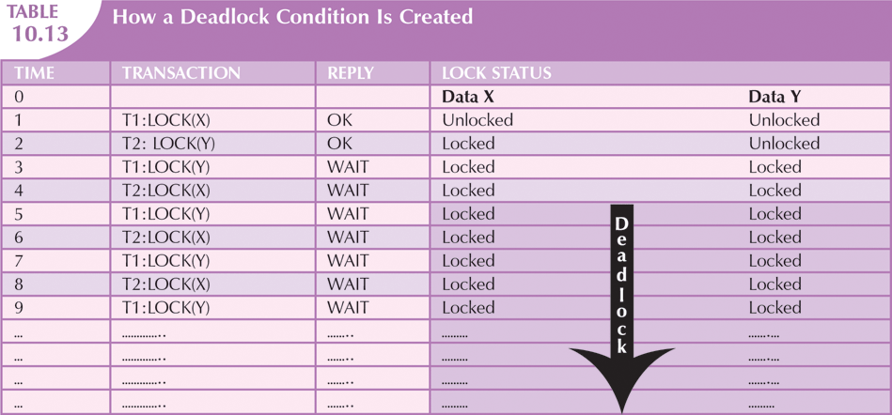
Database Systems, 9th Edition
‹#›

Slide 39
Concurrency Control with Time Stamping Methods
Assigns global unique time stamp to each transaction
Produces explicit order in which transactions are submitted to DBMS
Uniqueness
Ensures that no equal time stamp values can exist
Monotonicity
Ensures that time stamp values always increase
Database Systems, 9th Edition
‹#›

Slide 40
Wait/Die and Wound/Wait Schemes
Wait/die
Older transaction waits and younger is rolled back and rescheduled
Wound/wait
Older transaction rolls back younger transaction and reschedules it
Database Systems, 9th Edition
‹#›

Slide 41
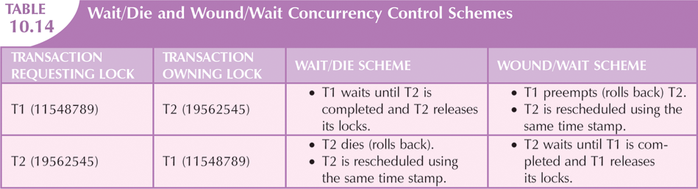
Database Systems, 9th Edition
‹#›

Slide 42
Concurrency Control with Optimistic Methods
Optimistic approach
Based on assumption that majority of database operations do not conflict
Does not require locking or time stamping techniques
Transaction is executed without restrictions until it is committed
Phases: read, validation, and write
Database Systems, 9th Edition
‹#›

Slide 43
Database Recovery Management
Restores database to previous consistent state
Based on atomic transaction property
All portions of transaction are treated as single logical unit of work
All operations are applied and completed to produce consistent database
If transaction operation cannot be completed:
Transaction aborted
Changes to database are rolled back
Database Systems, 9th Edition
‹#›

Slide 44
Transaction Recovery
Write-ahead-log protocol: ensures transaction logs are written before data is updated
Redundant transaction logs: ensure physical disk failure will not impair ability to recover
Buffers: temporary storage areas in primary memory
Checkpoints: operations in which DBMS writes all its updated buffers to disk
Database Systems, 9th Edition
‹#›

Slide 45
Transaction Recovery (cont’d.)
Deferred-write technique
Only transaction log is updated
Recovery process: identify last checkpoint
If transaction committed before checkpoint
Do nothing
If transaction committed after checkpoint
Use transaction log to redo the transaction
If transaction had ROLLBACK operation
Do nothing
Database Systems, 9th Edition
‹#›

Slide 46
Transaction Recovery (cont’d.)
Write-through technique
Database is immediately updated by transaction operations during transaction’s execution
Recovery process: identify last checkpoint
If transaction committed before checkpoint
Do nothing
If transaction committed after last checkpoint
DBMS redoes the transaction using “after” values
If transaction had ROLLBACK or was left active
Do nothing because no updates were made
Database Systems, 9th Edition
‹#›

Slide 47
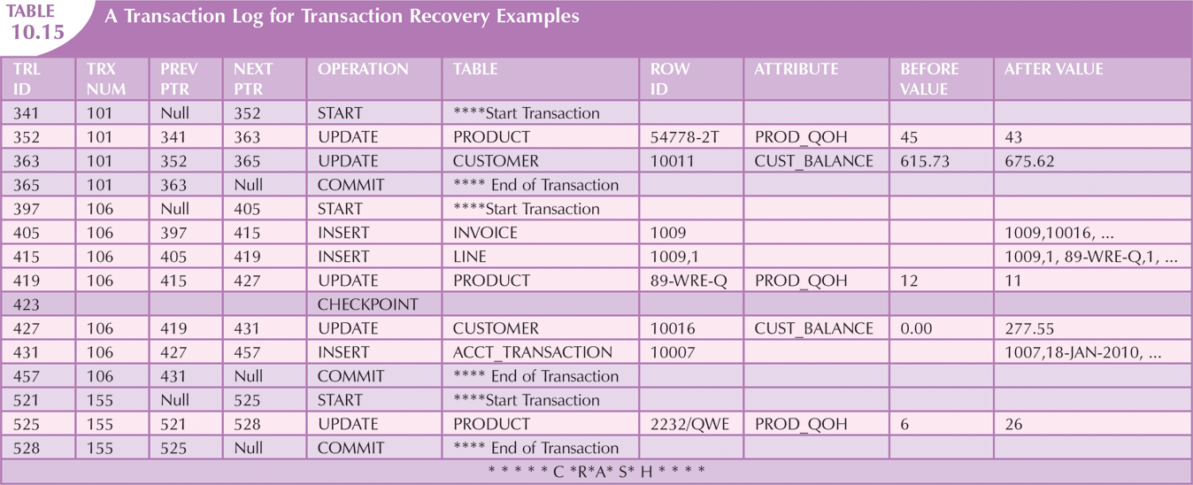
Database Systems, 9th Edition
‹#›

Slide 48
Summary
Transaction: sequence of database operations that access database
Logical unit of work
No portion of transaction can exist by itself
Five main properties: atomicity, consistency, isolation, durability, and serializability
COMMIT saves changes to disk
ROLLBACK restores previous database state
SQL transactions are formed by several SQL statements or database requests
Database Systems, 9th Edition
‹#›

Slide 49
Summary (cont’d.)
Transaction log keeps track of all transactions that modify database
Concurrency control coordinates simultaneous execution of transactions
Scheduler establishes order in which concurrent transaction operations are executed
Lock guarantees unique access to a data item by transaction
Two types of locks: binary locks and shared/exclusive locks
Database Systems, 9th Edition
‹#›

Slide 50
Summary (cont’d.)
Serializability of schedules is guaranteed through the use of two-phase locking
Deadlock: when two or more transactions wait indefinitely for each other to release lock
Three deadlock control techniques: prevention, detection, and avoidance
Time stamping methods assign unique time stamp to each transaction
Schedules execution of conflicting transactions in time stamp order
Database Systems, 9th Edition
‹#›

Slide 51
Summary (cont’d.)
Optimistic methods assume the majority of database transactions do not conflict
Transactions are executed concurrently, using private copies of the data
Database recovery restores database from given state to previous consistent state
Database Systems, 9th Edition
‹#›

